Slide 1
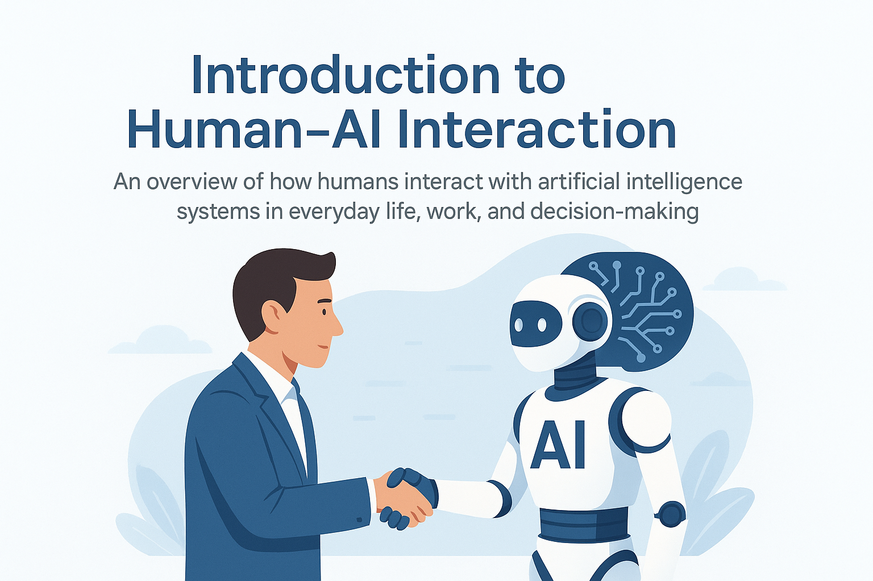
Introduction to Human AI interaction
Create AI that is efficient, ethical, and user-friendly
Dr. Ahmed Yousry
Faculty of Computers and Artificial Intelligence
ahmed.abdelsatar@fci.bu.edu.eg

Slide 2
Topics
What is Human–AI Interaction?
Difference between HCI & HAI
Importance of studying HAI
Examples in daily life
AI in communication
AI in decision making
AI vs. traditional computer interaction
Human role in AI systems
AI role in supporting humans
Key principles of HAI
Interactive AI technologies
AI in personal life (smartphones, apps)
AI in professional life (workplace tools)
Collaboration vs. automation
Benefits of HAI
Challenges in HAI
Case study (ChatGPT example)
Case study (Netflix recommendations)
Future vision of HAI
Summary

Slide 3
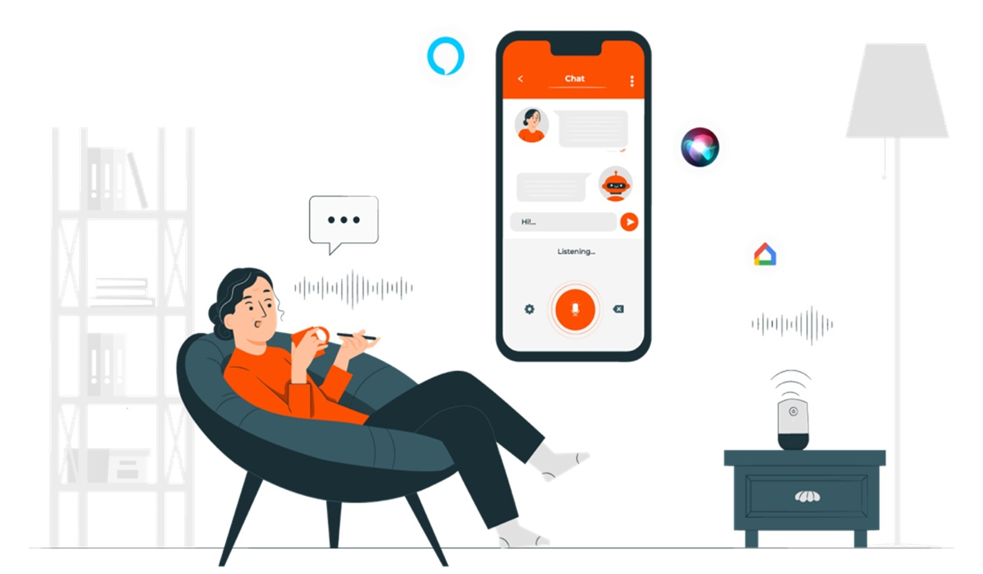
What is Human–AI Interaction?
Human–AI Interaction (HAI) is the study of how humans use and communicate with AI-powered systems.
It combines psychology علم النفس, computer science, and design.
Focus: making AI understandable, useful, and supportive.
Example: Talking to a voice assistant like Alexa.

Slide 4
Difference between HCI & HAI
HCI (Human–Computer Interaction): interaction with traditional computers that follow fixed instructions.
HAI (Human–AI Interaction): interaction with systems that learn, adapt, and make intelligent predictions.
Key difference: AI systems evolve with data, while traditional systems remain static.

Slide 5

Importance of Studying HAI
Helps design better AI systems that are user-friendly.
Reduces errors in critical fields such as medicine and finance.
Ensures AI is used ethically and transparently.
Improves productivity and efficiency in work and personal life.

Slide 6
Examples in Daily Life
Chatbots in online shopping and banking.
Netflix and YouTube recommendations.
Google Maps navigation and route planning.
Virtual assistants like Siri, Alexa, and Google Assistant.

Slide 7
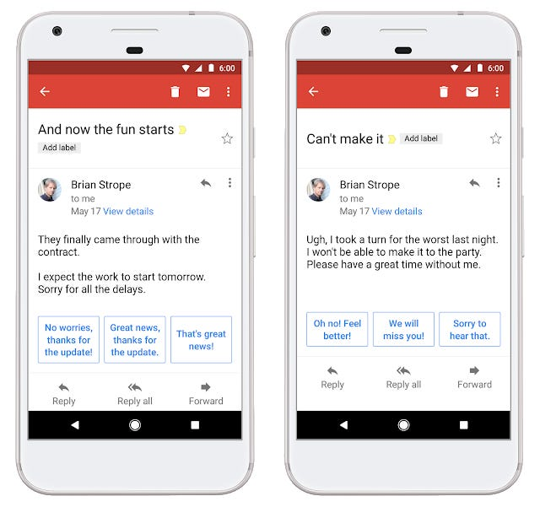
AI in Communication
Spam filters remove unwanted emails.
Smart replies and predictive text save time.
Real-time language translation breaks communication barriers.AI chatbots handle customer service 24/7.

Slide 8
AI vs. Traditional Computer Interaction
Traditional computers: require exact commands, no learning ability.
AI systems: adapt from experience, predict outcomes, and provide recommendations.
AI = more human-like interaction.

Slide 9
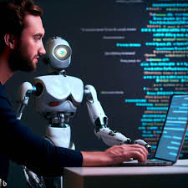
Human Role in AI Systems
Humans provide training data to AI.
Monitor AI outputs to prevent mistakes.
Define ethical boundaries and regulations قوانين .
Work alongside AI instead of being replaced.

Slide 10

AI Role in Supporting Humans
Performs repetitive or dangerous tasks.
Provides fast and accurate recommendations.
Increases speed and productivity at work.
Personalizes services (shopping, entertainment).

Slide 11
Key Principles of HAI
Transparency: AI decisions should be clear.
Trust: Systems must be reliable and unbiased.
Usability: AI must be easy to use.
Accountability: Humans should remain in control.

Slide 12

Interactive AI Technologies
Voice assistants (Siri, Alexa, Google Assistant).
01
Recommendation engines (Netflix, Amazon, YouTube).
02
Computer vision apps (face recognition, AR).
03
Conversational AI (ChatGPT, customer service bots).
04

Slide 13
AI in Personal Life
Smartphones: face unlock, predictive typing.
Online shopping: personalized product recommendations.
Social media: friend and feed suggestions.
Smart homes: voice-controlled lights, security, and thermostats.

Slide 14
AI in Professional Life
Business: AI chatbots manage customer inquiries.
HR: AI filters resumes and selects candidates.
Data analytics: generates insights and predictions.
Healthcare: AI supports doctors with diagnoses.

Slide 15
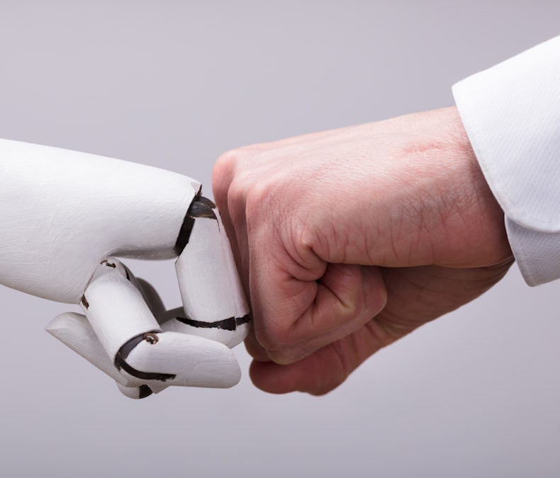

Collaboration vs. Automation
Collaboration: Humans and AI work together (AI as an assistant).
Automation: AI performs tasks independently, replacing humans.
Example: Collaborative robots (cobots) vs. fully automated machines.

Slide 16
Benefits of HAI
Faster and more accurate decision-making.
Easier and more natural communication.
Personalized services based on user preferences.
Reduces human workload and stress.

Slide 17
Challenges in HAI
Errors or wrong AI outputs.
Data bias leading to unfair decisions.
Ethical and privacy issues.
Risk of over-reliance on AI systems.

Slide 18
Case Study: ChatGPT
Developed by OpenAI as a conversational AI.
Applications: education, customer service, coding help.
Strengths: generates natural human-like responses.
Limitations: can sometimes provide biased or inaccurate information.

Slide 19
Case Study: Netflix
Uses machine learning to recommend shows and movies.
Analyzes viewing history, ratings, and preferences.
Benefit: keeps users engaged and entertained.
Challenge: “filter bubble” effect (users only see similar content).

Slide 20
Future Vision & Summary
Future AI will be more transparent, adaptive, and human-friendly.
Human–AI collaboration will expand in workplaces, homes, and society.
Summary: HAI = building trust, usability, and ethical collaboration between humans and machines.

Slide 21
Course Information and contact
Materials
All materials will be available at my BU page
link: https://bu.edu.eg/staff/ahmed.abdelsatar
Email: ahmed.abdelsatar@fci.bu.edu.eg
I need the admin to contact me for any further announcements.

Slide 22
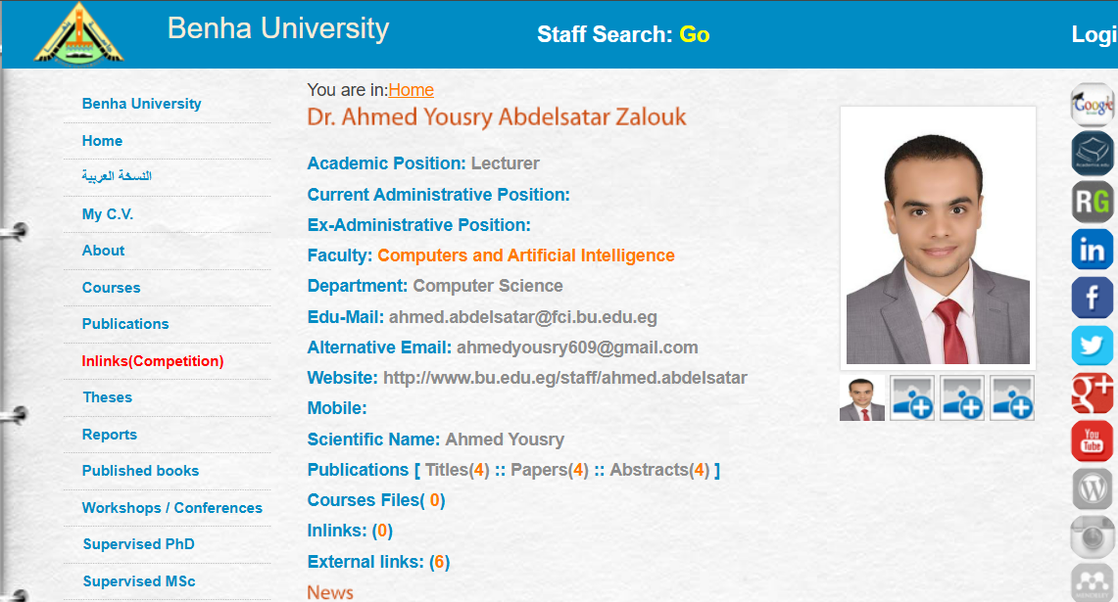
Course Information

Slide 23
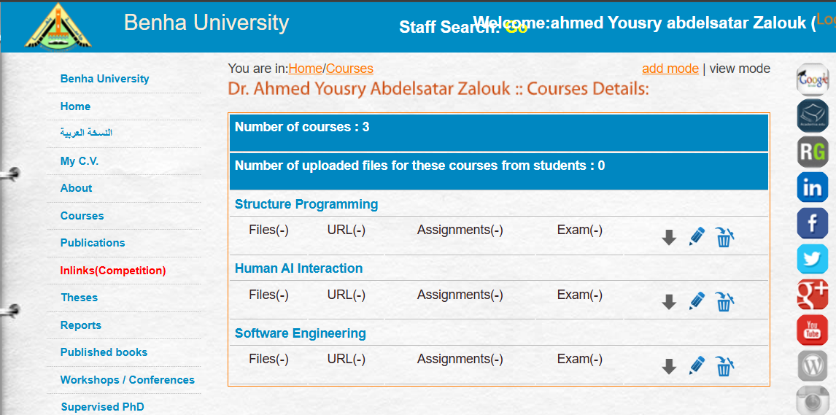
Course Information

Slide 24
Course Information
Grade Distribution*
- Total Grade 100
  Final Exam 50
  Year’s Work 50
- Year’s Work:
  Mid-Term Exam 20
  Labs 20
  Oral 10
*: subject to change during the term

Slide 25

Thanks

